Slide 1





Redux
by Bohdan Zhylavskyi
magnise.com

Slide 2
Two types of complexity
Essential (necessary) complexity
Is caused by the characteristics of the problem to be solved and cannot be reduced.
Accidental complexity
Refers to challenges that developers unintentionally make for themselves as a result
of trying to solve a problem.

Slide 3


Slide 4


Slide 5
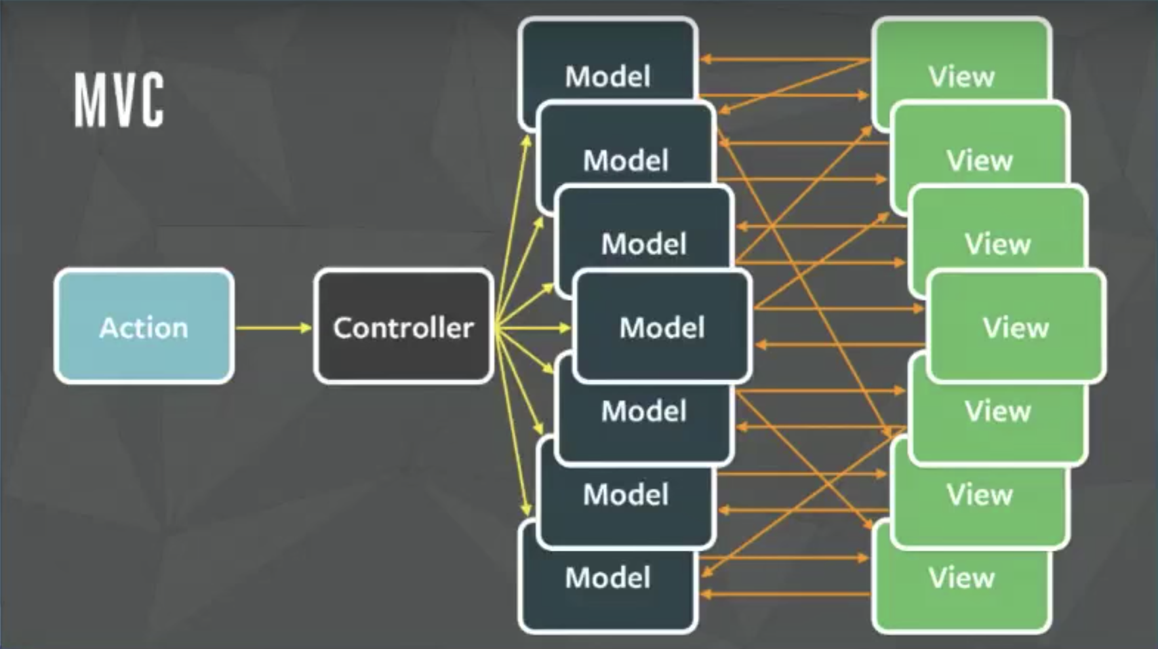

Slide 6
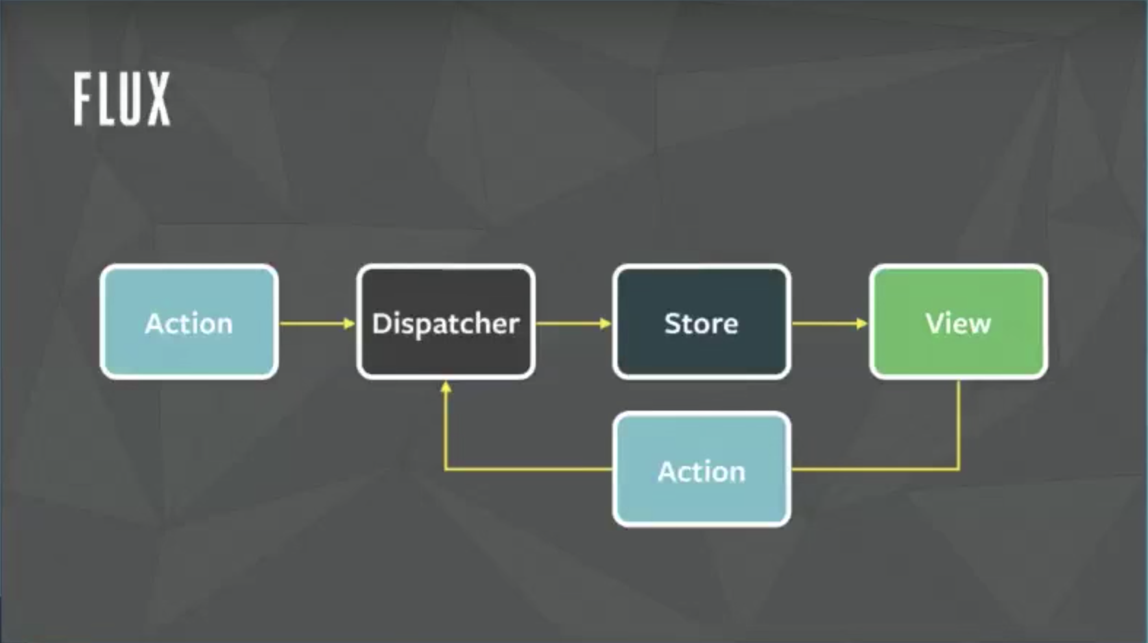

Slide 7
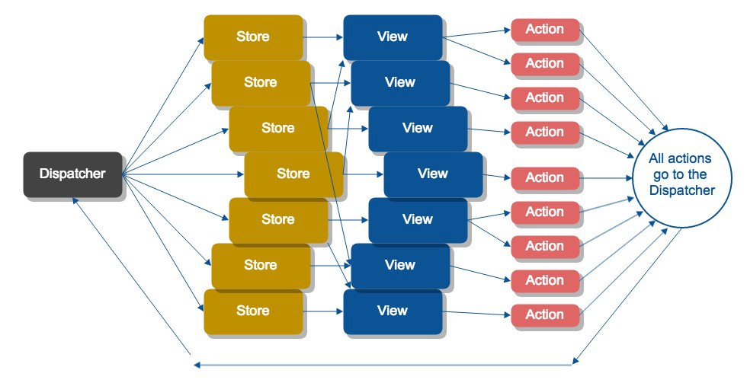
Complex FLUX

Slide 8
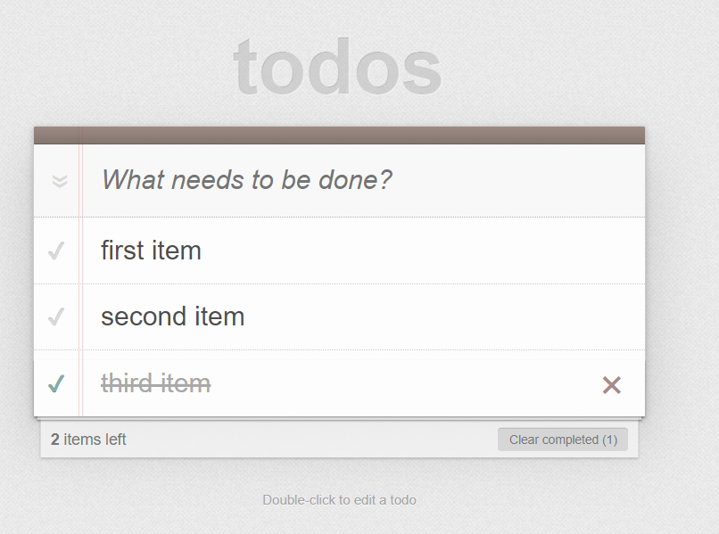
Example

Slide 9
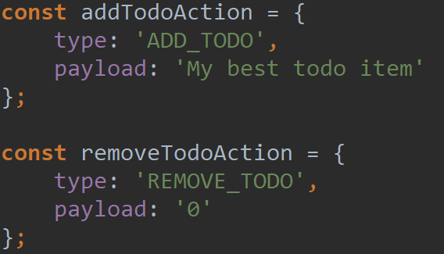

Slide 10
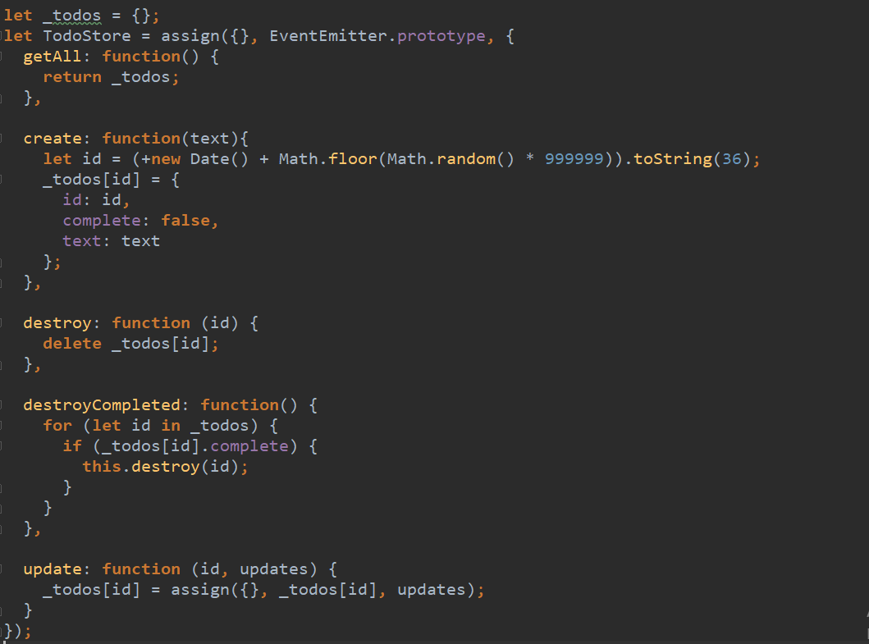

Slide 11
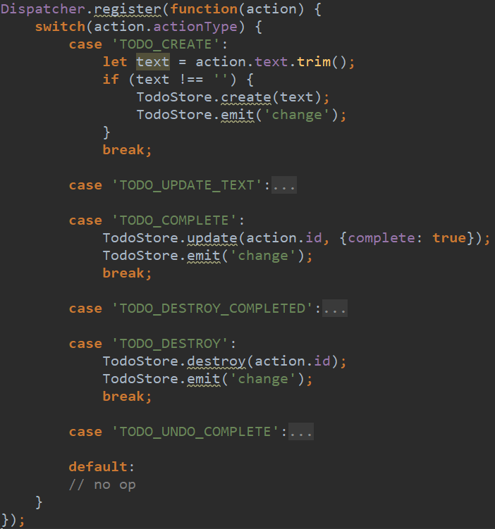
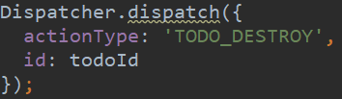

Slide 12
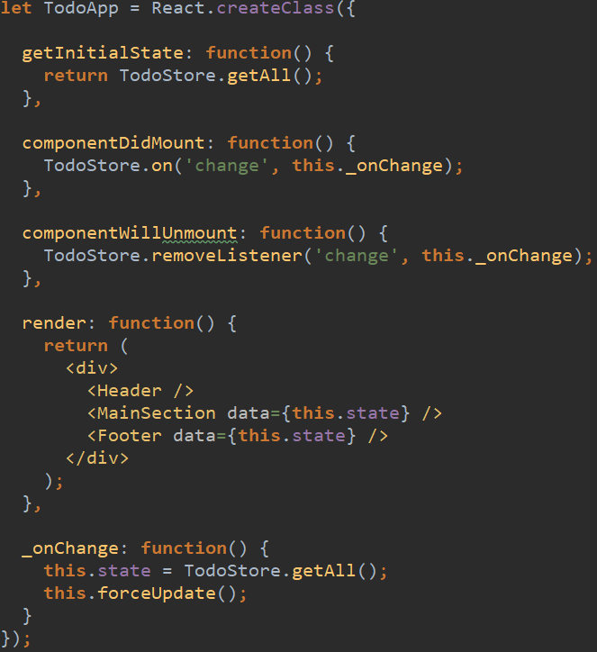

Slide 13


Slide 14
Flux summary
1. Flux elements: Actions, Dispatcher, Stores
2. Stores contains applications data and business logic
3. Views change applications data via Actions
4. Action is simple object that describes user intent
5. Stores using Dispatcher subscribes to particular Actions and updates itself accordingly
6. Views subscribe to particular stores when it updates to rerender itself

Slide 15


Redux: Three Principles
1. Single source of truth
2. State is read-only
3. Changes are made with pure functions

Slide 16
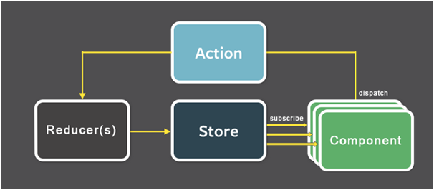

Slide 17
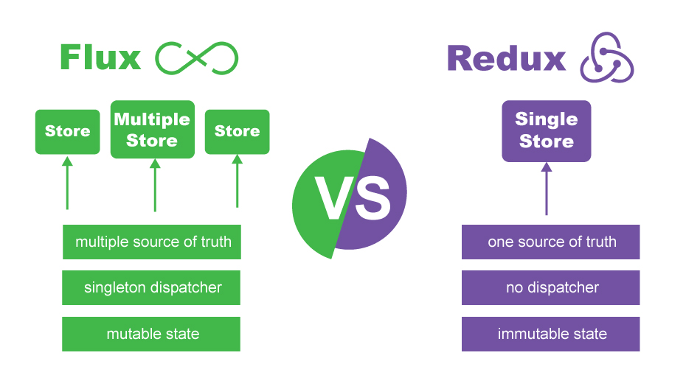

Slide 18
Pure Functions
1. Given the same input, will always return the same output
2. Produces no side effects (No surprises. No side effects. No API calls. No mutations)
A dead giveaway that a function is impure is if it makes sense to call it without using its return value.

Slide 19

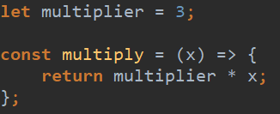
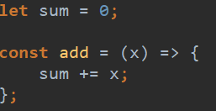

Slide 20
Benefits Of Pure Functions
1. They’re easier to reason about
2. They’re easier to combine
3. They’re easier to test
4. They are memoizable*
Memoization is storing the results of expensive function calls and returning the cached result
when the same inputs occur again.

Slide 22
Redux: Reducer
1. Reducers specify how the application's state changes in response to actions
2. The reducer is a pure function that takes the previous state and an action, and returns the next state.
(previousState, action) => newState

Slide 23

NGRX

Slide 24
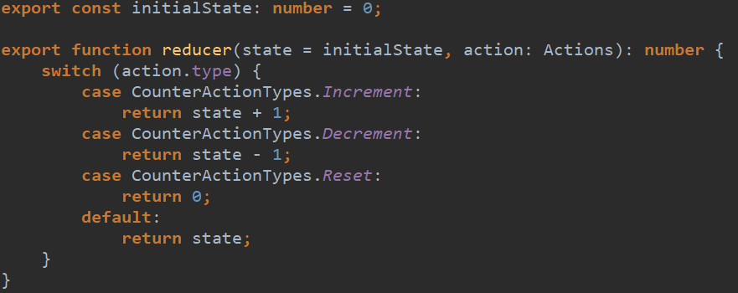
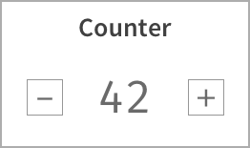



Slide 26

Finish!

